Slide 1
Cache Timing Attacks
신 영 주
syoungjoo@korea.ac.kr

Slide 2



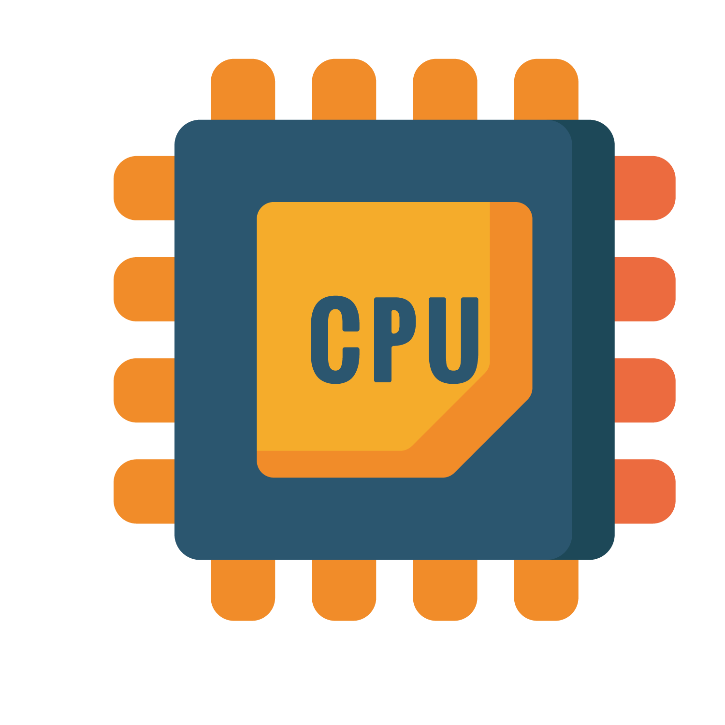
Software-based system protection
SW-based isolation for different security domains
User process vs. kernel in OS → page protection
JavaScript code vs. web browser → sandboxing
Guest VMs on multi-tenant cloud → virtualization
SW-based
isolation
Victim
Attacker
System software
(OS, Hypervisor)

Slide 3
Threats to software-based system protection
Contention on shared cache creates side-channels
Cache timing attacks break the SW-based protection
SW-based
isolation
Victim
Attacker
System software
(OS, Hypervisor)
Secret
Cache side-channel

Slide 4
Basics of cache timing attacks

Slide 5

Cache memory
Exploits principle of locality
Example
request for data at location A is served with high latency (Cache miss)
request for data at location B is served with low latency (Cache hit)
timing
difference!
Code
or
data
② Fetch
address A
① Request A
③ Load
④ Request B
address B
⑤ Load
Cache
Main memory (DRAM)

Slide 6
Cache memory
Timing measurement
time = rdtsc();
maccess(&addressA);
deltaA = rdtsc() - time;
time = rdtsc();
maccess(&addressB);
deltaB = rdtsc() - time;

Slide 7
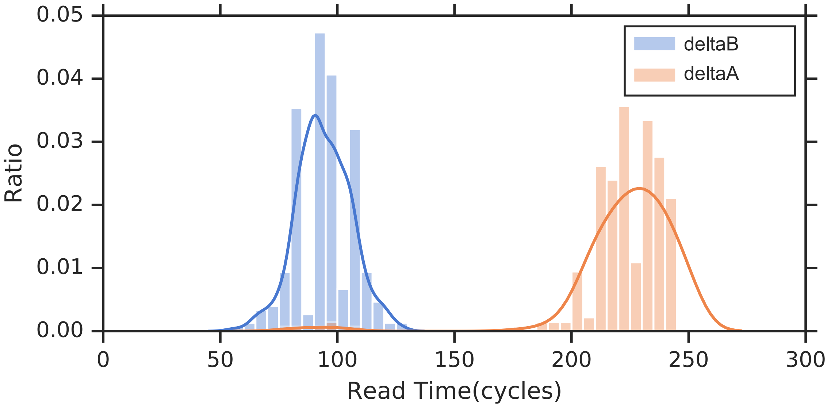
Cache memory
Timing measurement

Slide 8
Cache memory
Victim
Attacker
System software
(OS, Hypervisor)
Core
Core
L1 cache
L1 cache
L2 cache
L2 cache
Last-level cache (LLC or L3)
Main memory

Slide 9
Cache memory
Victim
Attacker
L3 cache
System software
(OS, Hypervisor)
Core
Core
L1 cache
L1 cache
L2 cache
L2 cache
Last-level cache (LLC or L3)
Main memory

Slide 10
Cache memory
Victim
Attacker
Cache line (64 bytes)
L3 cache
System software
(OS, Hypervisor)
Core
Core
L1 cache
L1 cache
L2 cache
L2 cache
Last-level cache (LLC or L3)
Main memory

Slide 11
Cache memory
Victim
Attacker
Cache set
L3 cache
System software
(OS, Hypervisor)
Core
Core
L1 cache
L1 cache
L2 cache
L2 cache
Last-level cache (LLC or L3)
Main memory
Set 1 Set 2 Set 3 … Set N

Slide 12
Cache memory
Victim
Attacker
Cache set
L3 cache
System software
(OS, Hypervisor)
Line 1
Core
Core
Line 2
L1 cache
L1 cache
L2 cache
L2 cache
…
Last-level cache (LLC or L3)
Line W
Main memory
W associativity - a cache set has W lines

Slide 13
Flush+Reload
Attacker flushes a target cache line
L3 cache

Slide 14
Flush+Reload
Attacker flushes a target cache line
L3 cache
Flush

Slide 15
Flush+Reload
Attacker flushes a target cache line
Victim accesses/does not access (depending on secret)
L3 cache
Mem read

Slide 16
Flush+Reload
Attacker flushes a target cache line
Victim accesses/does not access depending on secret
Attacker re-accesses (reload) memory
Fast access time → victim accessed
Slow access time → victim did not
L3 cache
Reload

Slide 17
Flush+Reload
Flush+Reload code
rdtscp : read time stamp counter
clflush : flushing cache line
mfence
rdtscp
mov %eax, %esi
mov (%ebx), %eax
rdtscp
sub %esi, %eax
clflush 0(%ebx)

Slide 18
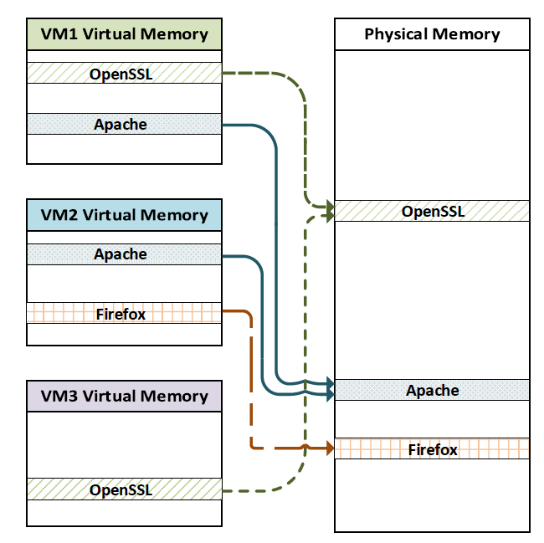
Flush+Reload
Prerequisite
Memory sharing between attacker and victim required
Memory sharing among virtual machines
Hypervisor supports memory deduplication
E.g., TPS (Transparent Page Sharing) in VMWare, KSM (Kernel Samepage Merging) in KVM

Slide 19
Prime+Probe
Attacker primes
L3 cache
Set #n
Prime

Slide 20
Prime+Probe
Attacker primes
Victim accesses/not accesses (depending on secret)
L3 cache
Set #n
Mem read

Slide 21
Prime+Probe
Attacker primes
Victim accesses/not accesses (depending on secret)
Attacker re-access (probe)
Slow access time → victim accessed
Fast access time → victim did not
L3 cache
Set #n
Probe

Slide 22
Comparison
Flush+Reload | Prime+Probe
High resolution (500 cycles) Low noise | Low resolution (> 5,000 cycles) High noise
Memory sharing required | Memory sharing not necessary

Slide 23
Examples of cache timing attacks

Slide 24
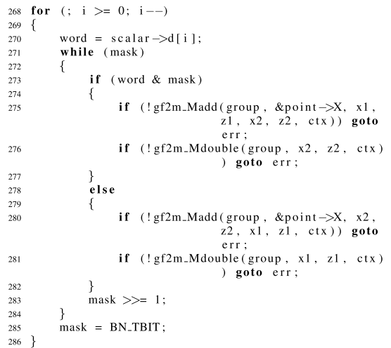
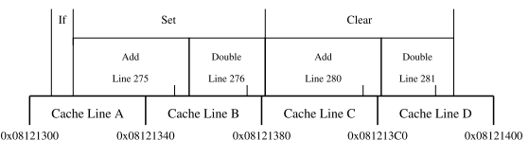
Attack on ECDSA
Montgomery ladder multiplication in OpenSSL 1.0.1e [YN14]
Montgomery ladder implementation in OpenSSL 1.0.1e
[YN14] Yarom, Y., & Naomi, B.. Recovering OpenSSL ECDSA Nonces Using the FLUSH+RELOAD Cache Side-channel Attack. ePrint archive 2014

Slide 25
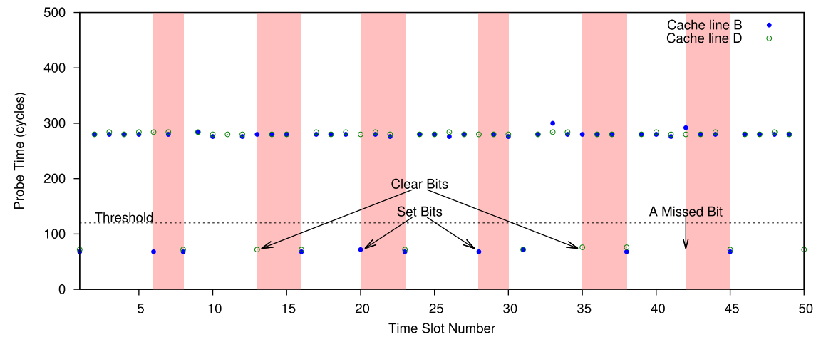
Attack on ECDSA
Montgomery ladder multiplication in OpenSSL 1.0.1e [YN14]
Probe timing during signing operation
[YN14] Yarom, Y., & Naomi, B.. Recovering OpenSSL ECDSA Nonces Using the FLUSH+RELOAD Cache Side-channel Attack. ePrint archive 2014

Slide 26
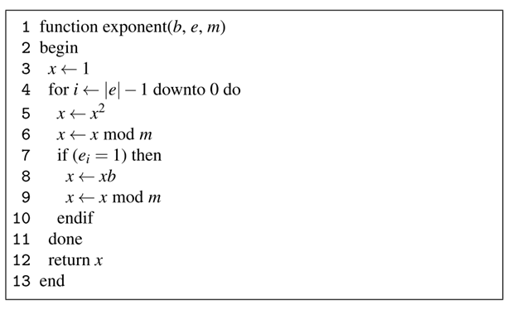
Attack on RSA
Square-and-Multiply implementation on GnuPG 1.4.13 [YF14]
Square
Reduce
Multiply
[YF14] Yarom, Y., & Falkner, K. (2014). Flush + Reload : a High Resolution , Low Noise , L3 Cache Side-Channel Attack. USENIX Security 2014

Slide 27
Attack on RSA
Square-and-Multiply implementation on GnuPG 1.4.13 [YF14]
<RSA decryption (Victim VM)>
victim@guest1:$ gpg –d ciphertext.gpg
gpg: encrypted with 2048-bit RSA key, ID 7E2BFBC6, created 2016-11-14
<Flush+Reload attack (Spy VM)>
attacker@guest2:$ spy mygpg.conf
Mapped at 0xf7142000
|S|Sr|Sr||M|M|rM|S||Sr|||S|Sr|rM|||Sr|||rM|||Sr|||Sr|||M||||Sr|||Sr|||rM|||Sr|||Sr|||Sr
…
S:Square, M:Multiply, r:Reduce
Square
Reduce
Multiply
Reduce
Square
Reduce
Square
Reduce
Multiply

Slide 28
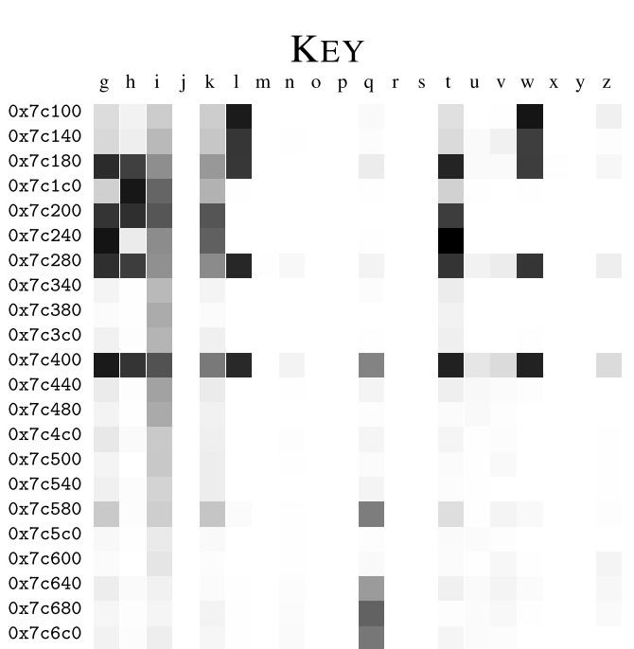
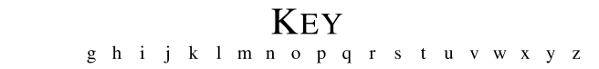
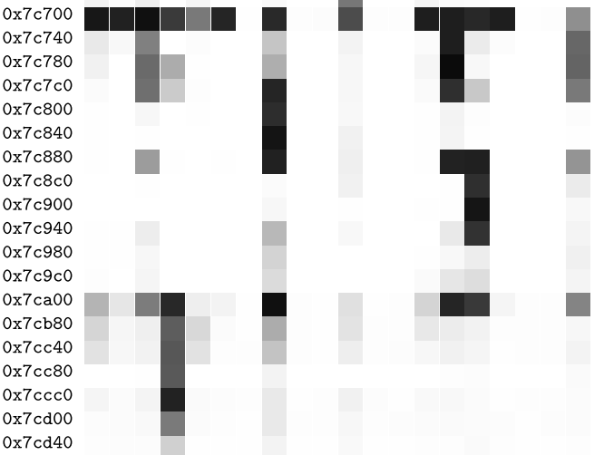
Retrieving key stroke information
Targets on GDK library (libgdk-3.so.0.1000.8) in Linux default user interface framework [GSM15]
address
[GSM15] Gruss, D., Spreitzer, R., & Mangard, S. (2015). Cache Template Attacks: Automating Attacks on Inclusive Last-Level Caches. Proceedings of the 24th USENIX Security Symposium.

Slide 29
Countermeasure

Slide 30
Constant time programming
No variable-time instructions
No secret-dependent memory access
No secret-dependent flow control

Slide 31
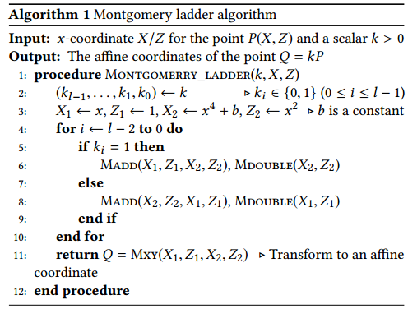
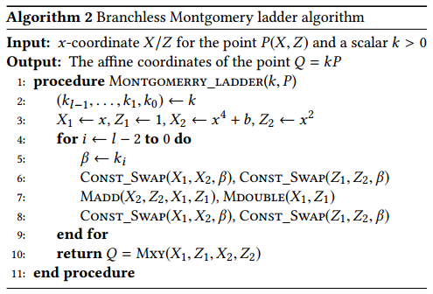
Constant time programming (Cont’d)
Non constant-time
Constant-time

Slide 32
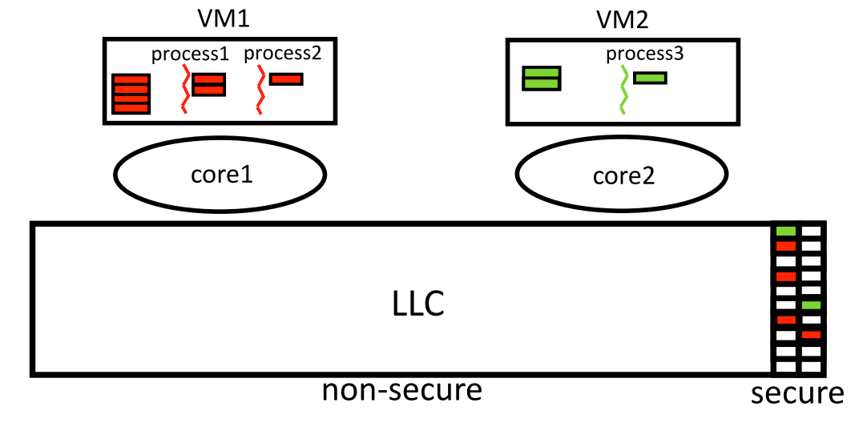
Cache partitioning
Intel Cache Allocation Technology (CAT)
provides software control to isolate LLC access between VMs
CATalyst [FQY16]
[FQY16] Liu, F., Ge, Q., Yarom, Y., Mckeen, F., Rozas, C., Heiser, G., & Lee, R. B. (2016). CATalyst: Defeating last-level cache side channel attacks in cloud computing. 2016 IEEE HPCA

Slide 33
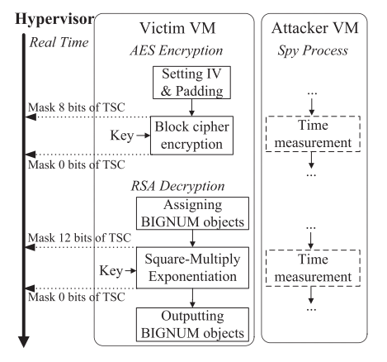
Adding noise to time sources
On-demand time blurring [WDM2017]
[WDM2017] W.Liu, D.Gao, M.Reiter, “On-Demand Time Blurring to Support Side-Channel Defense,” in ESORICS 2017

Slide 34
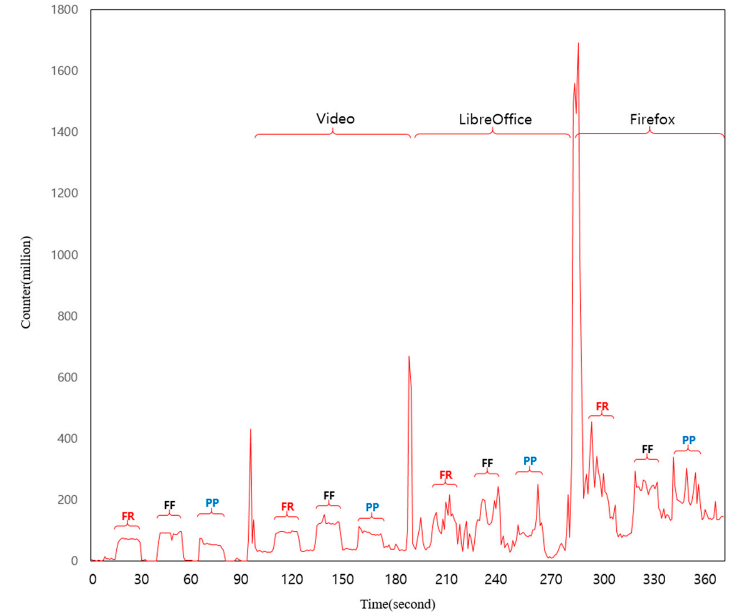
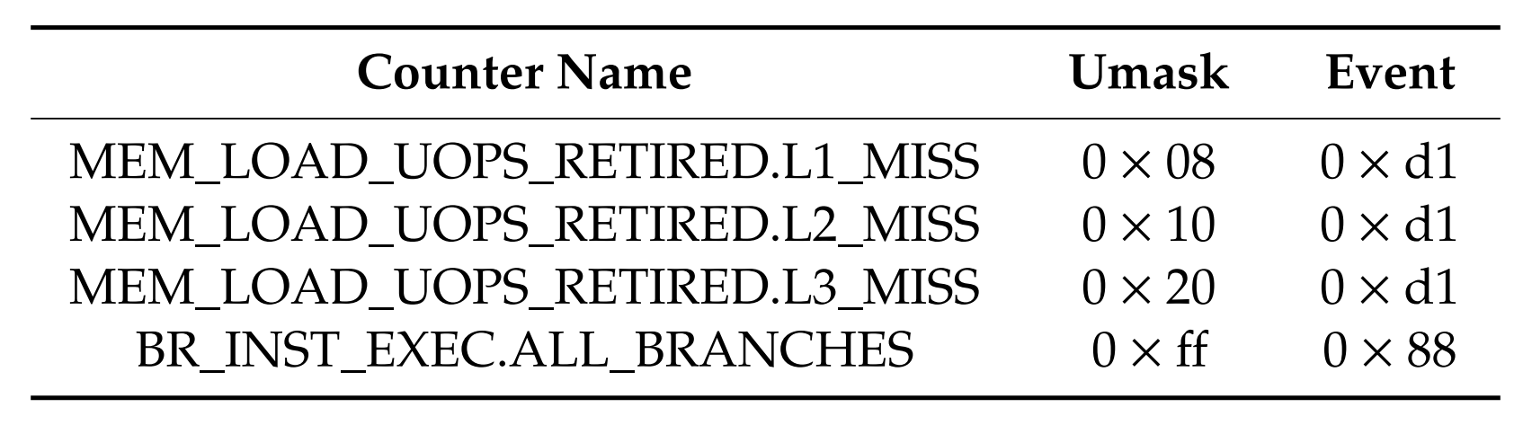
Runtime detection
Utilizes hardware performance counters
Hardware performance counters

Slide 35
Thanks
Notes:
Thanks for listening my talk.
You may refer to the paper for more details about my presentation.
Or If you have any questions about the paper, you can reach me through my email.
Thanks

